Slide 1
Predicting the Weather
Presented by Joseph Arewa & Vincenzo Piccolo

Slide 2
Hypothesis / Core message
Given the flood related issues from Hurricane Ida as well as our current battle with global warming we want to explore ways to better prepare for natural disasters. Can we leverage machine learning algorithms to predict weather patterns and occurrences?

Slide 3

Our Approach: Will it Rain there?

Slide 4
Our Models
Since we are creating a model that focuses on forecasting weather; we decided to use supervised learning models. A random forest is a Bagging-based algorithm that fits a number of classifying decision trees on various sub-samples of the dataset and uses averaging to improve the predictive accuracy and control over-fitting.
Models used:
Linear Regression
Random Forest Regressor
Random Forest Classifier

Slide 5
Data Preparation / Model Training
The datasets contains 5 years of high temporal resolution (hourly measurements) data of various weather attributes, such as temperature, humidity, air pressure, and weather description for 36 countries.
Project focus:
City: Philadelphia
Predicting Temperature
Defined and predict Rainfall

Slide 6
Model Evaluation: Numerical Summary
Linear Regression
Score of training dataset: 0.1285
Score of testing dataset: 0.1241
r2_score of model: 0.1241
MSE of model: 92.6434
RSME of model: 9.6251
Random Forest Regressor
Score of training dataset: 0.929
Score of testing dataset: 0.4858
r2_score of model: 0.4858
MSE of model: 53.5226
RSME of model: 7.3159

Slide 7
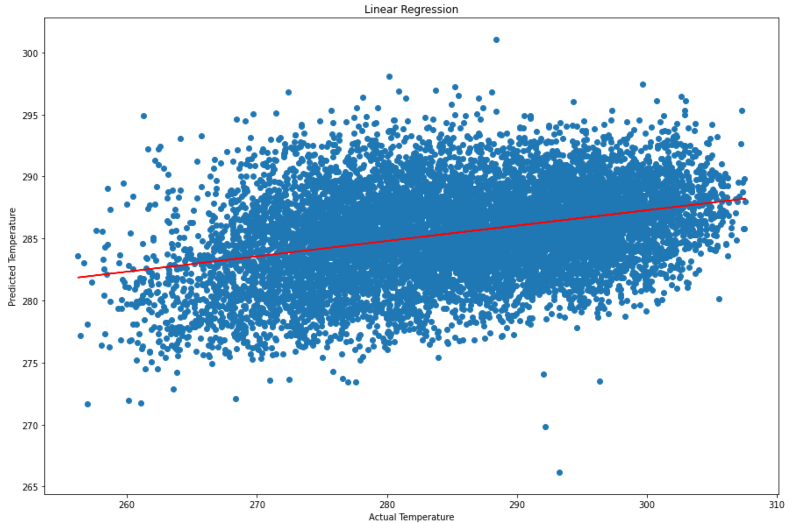
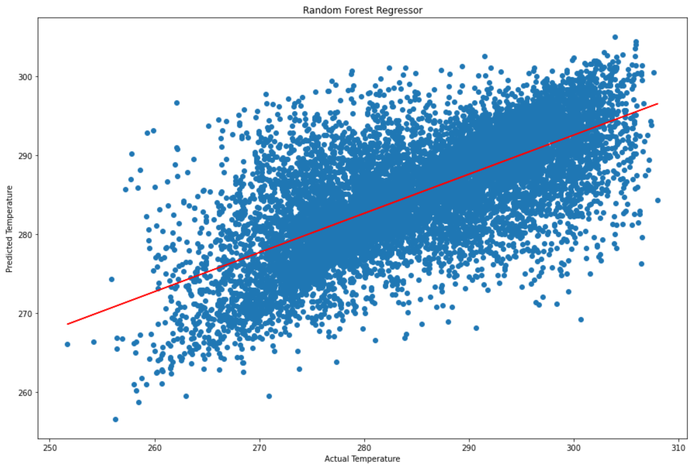
Model Evaluation: Visualization

Slide 8
Improving Model with Random Forest Classifier

Slide 9
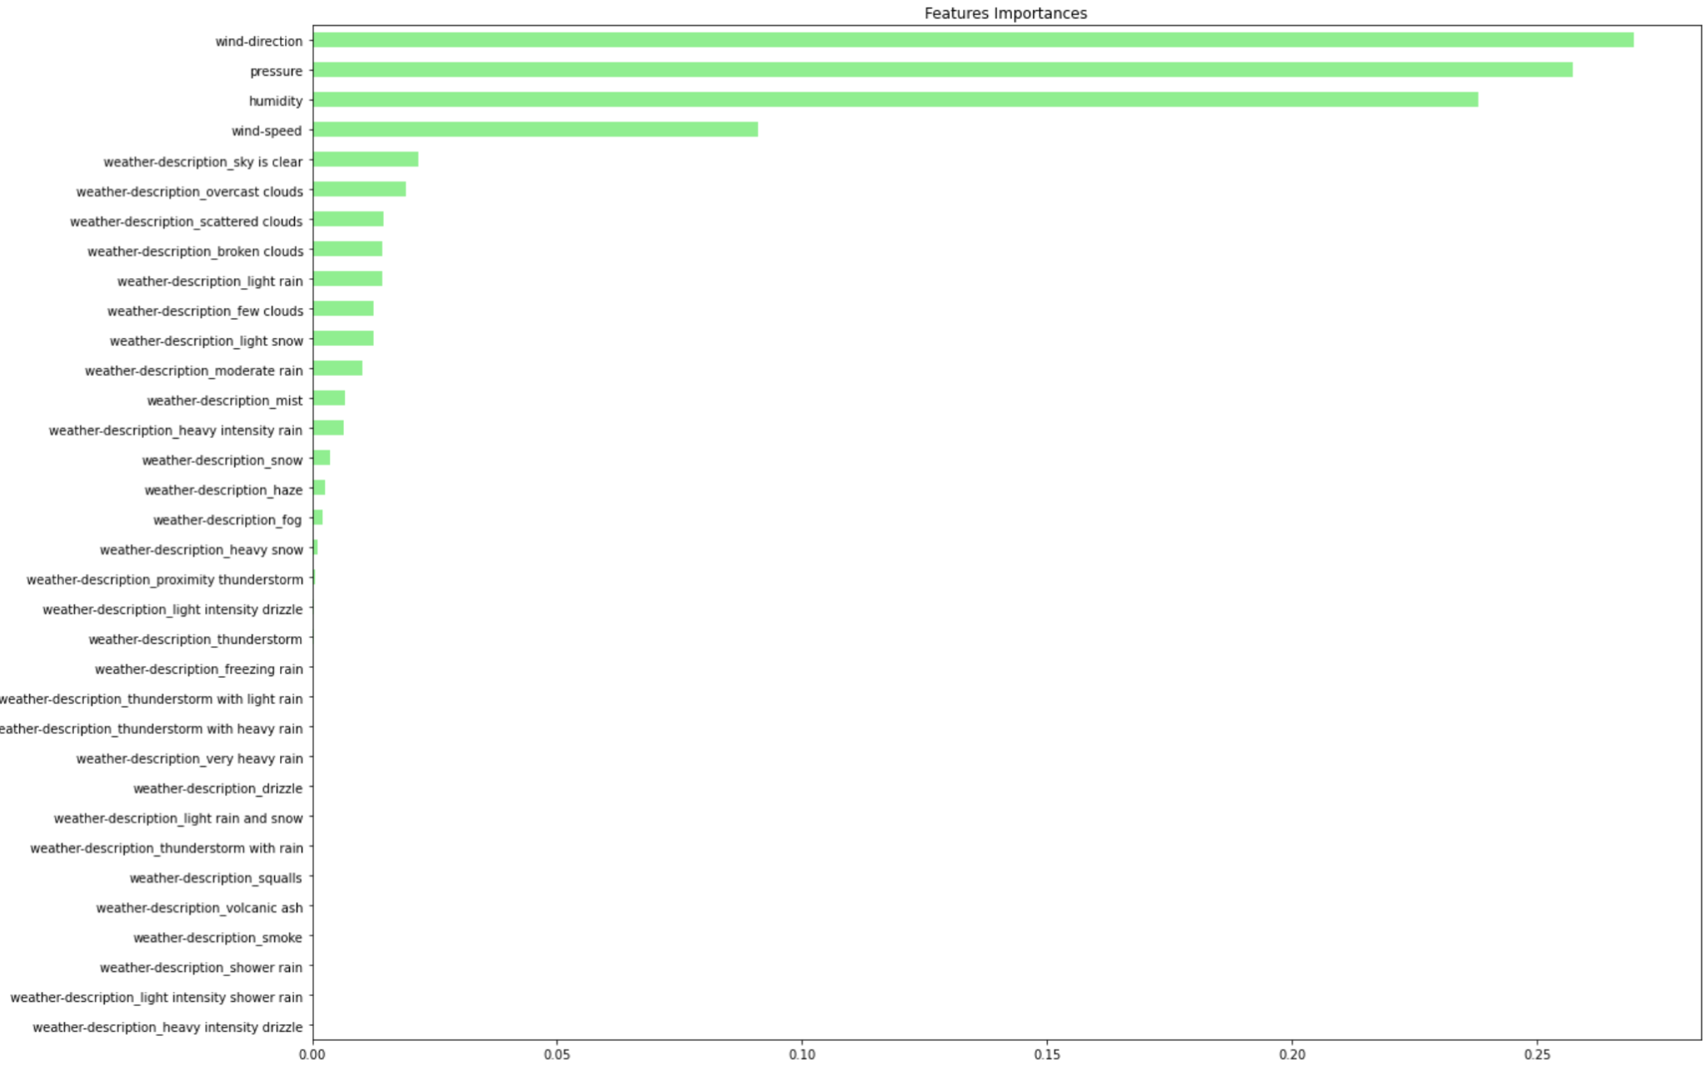
Feature importance

Slide 10
Random Forest Classifier
Score of training dataset: 0.999
Score of testing dataset: 0.8732
r2_score of model: 0.0627*
MSE of model: 0.1268
RSME of model: 0.3561
Model Evaluation
*: value could be a result of hard coding the rain column

Slide 11
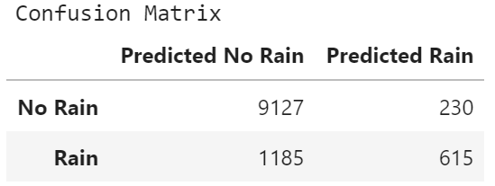
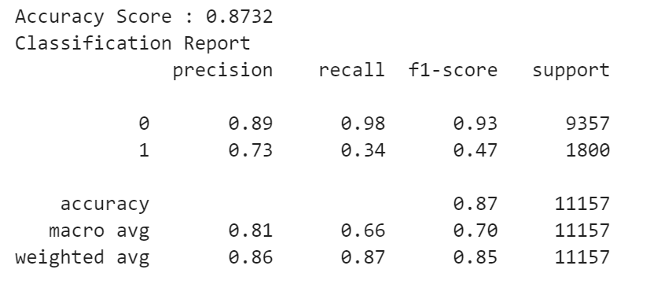
Model Evaluation: Classification Report

Slide 12
Conclusion
We barely scratched the surface!
We can leverage more ensemble learners improves accuracy and robustness, as well as decrease variance.
Our model showed:
Precision relates to a low false positive rate
There were significant false negatives in predicting rain

Slide 13
Any Questions?

Slide 14
Next Steps
Create interactive interface using AWS: users decide which city to explore
Create a more robust evaluation to predict other natural occurrences
Expand current data set to include different countries and cities
Leverage Weather API

